Slide 1

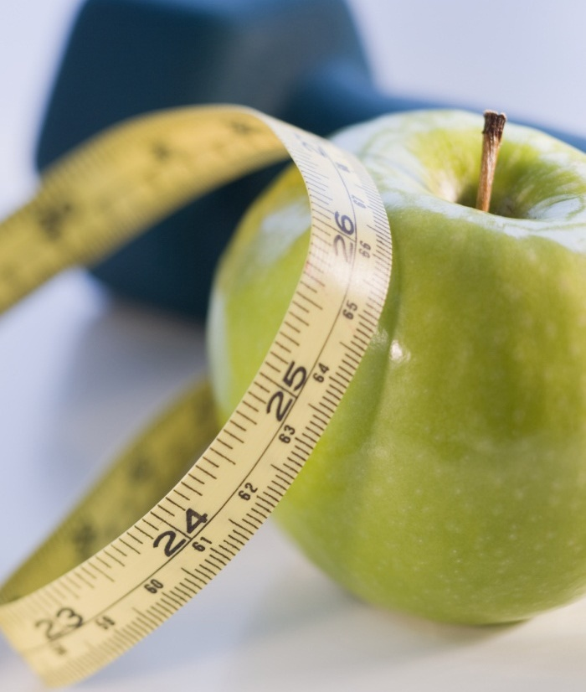

Health application
Guaranteed weight loss

Slide 2


Are you bothered by your weight?

Slide 3
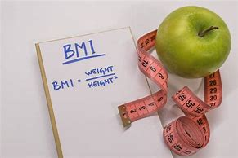
Studies show that by just tracking your weight and caloric intake you can maintain healthy BMI(Body Mass Index).

Slide 4
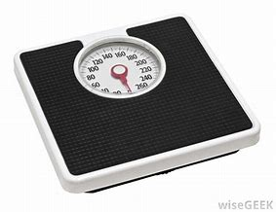
Check out our Health App. Calculates BMI (Body Mass index),and BMR (Basal Metabolic Rate) in the privacy of your own home

Slide 5

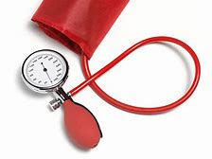
But wait, there’s more it also tracks Blood pressure and Glucose

Slide 6

Let our Healthcare Application help you meet your goals so you can enjoy the freedom a healthy lifestyle provides

